Slide 1
Cyber Security
Lecture 5-6

Slide 2
Types of threats
Natural threats: storms,
Cold/heat, earthquake, etc.
Chemical/biological/radiological:
Hospital, factory, spill
Malicious human:
Hacker/cracker, espionage, EX-employee
Non-malicious human: Deleting, typo,
unplugging, lack of training, made a mistake
Notes:
Students? Any unusual threats you’ve had to deal with in your career.

Slide 3
Security Threats
Malware
▪ Short-hand term for malicious software
Unauthorized Access
▪ Occurs when access to computer resources and data occurs without the consent of the owner
System Failure
▪ Occurs when a computer crashes or an individual application fails
Social Engineering
▪ Act of manipulating users into revealing confidential information or
performing other detrimental actions

Slide 4
Mitigating Threats
Physical Controls
Alarm systems, locks, surveillance cameras, identification cards, and security guards
Technical Controls
Smart cards, encryption, access control lists (ACLs), intrusion detection systems, and network authentication
Administrative Controls
Policies, procedures, security awareness training, contingency planning, and disaster recovery plans
▪User training is the most cost-effective security control to use

Slide 5
Hackers
Five Types of Hackers
White Hats
Non-malicious hackers who attempt to break into a company’s systems at their request
Black Hats
Malicious hackers who break into computer systems and networks without authorization or permission
Gray Hats
Hackers without any affiliation to a company who attempt to break into a company’s network but risk the law by doing so
Blue Hats
Hackers who attempt to hack into a network with permission of the company but are not employed by the company
Elite
Hackers who find and exploit vulnerabilities before anyone else does1 in 10,000 are elite
Script kiddies have limited skill and only run other people’s exploits and tools

Slide 6
Malware Infections
Malware Infection
Threat Vector: Method used by an attacker to access a victim’s machine
Attack Vector: Method used by an attacker to gain access to a victim’s machine in order to infect it with malware
Common Delivery Methods
Malware infections usually start within software, messaging, and media
Watering Holes:Malware is placed on a website that you know your potential victims will access

Slide 7
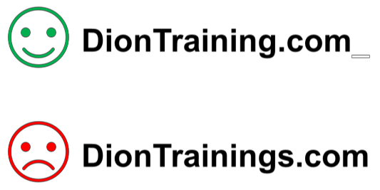
Malware Infections
Confuse

Slide 8
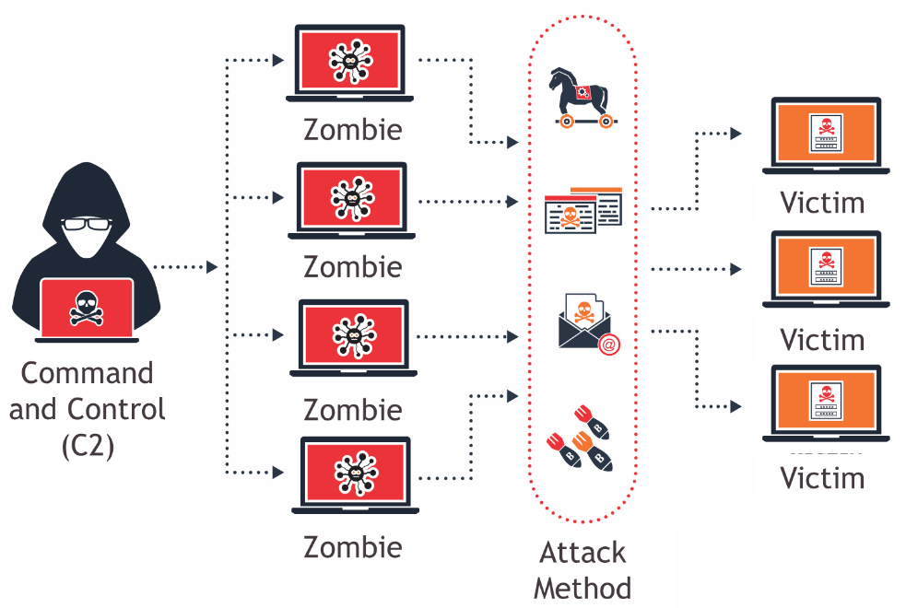
Botnets and Zombies
A collection of compromised computers under the control of a master node
Botnets can be utilized in other processor intensive functions and activities

Slide 9
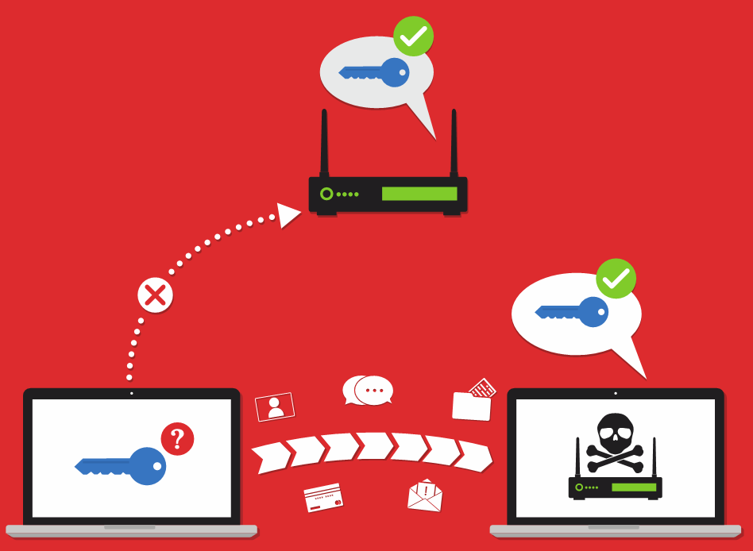
Active Interception & Privilege Escalation
Active Interception
Occurs when a computer is placed between the sender and receiver and is able to capture or modify the traffic between them
Privilege Escalation
Occurs when you are able to exploit a design flaw or bug in a system to gain access to resources that a normal user isn’t able to access

Slide 10
Backdoors and Logic Bombs
Backdoors are used to bypass normal security and authentication functions
Remote Access Trojan (RAT) is placed by an attacker to maintain persistent access
Logic Bomb :Malicious code that has been inserted inside a program and will execute only when certain conditions have been met
Easter Egg: Non-malicious code that when invoked, displays an insider joke, hidden message, or secret feature
Logic bombs and Easter eggs should not be used according to secure coding standards

Slide 11
Symptoms of Infection
Your computer might have been infected if it begins to act strangely
Hard drives, files, or applications are not accessible anymore
Strange noises occur
Unusual error messages
Display looks strange
Jumbled printouts
Double file extensions are being displayed, such as textfile.txt.exe
New files and folders have been created or files and folders are missing/corrupted
System Restore will not function

Slide 12
Removing Malware
Identify symptoms of a malware infection
Quarantine the infected systems
Disable System Restore (if using a Windows machine)
Remediate the infected system
Schedule automatic updates and scans
Enable System Restore and create a new restore point
Provide end user security awareness training
If a boot sector virus is suspected, reboot the computer from an external device and scan it

Slide 13
Preventing from Malware
-Viruses -Worms -Trojans -Ransomware -Spyware -Rootkits -Spam
Worms, Trojans, and Ransomware are best detected with anti-malware solutions
Scanners can detect a file containing a rootkit before it is installed…
removal of a rootkit is difficult and the best plan is to reimage the machine
Verify your email servers aren’t configured as open mail relays or SMTP open relays
Use whitelists and blacklists
Train and educate end users
Update your anti-malware software automatically and scan your computer
Update and patch the operating system and applications regularly

Slide 14
Hands On Project
In this activity, you will install VMware in your laptop and install kali Linux in virtualized environment for system and familiarize yourself with the interface and the devices.

